Slide 1
Git Visualized
Back to the Basics
May 17, 2016

Slide 2
Questions

Slide 3
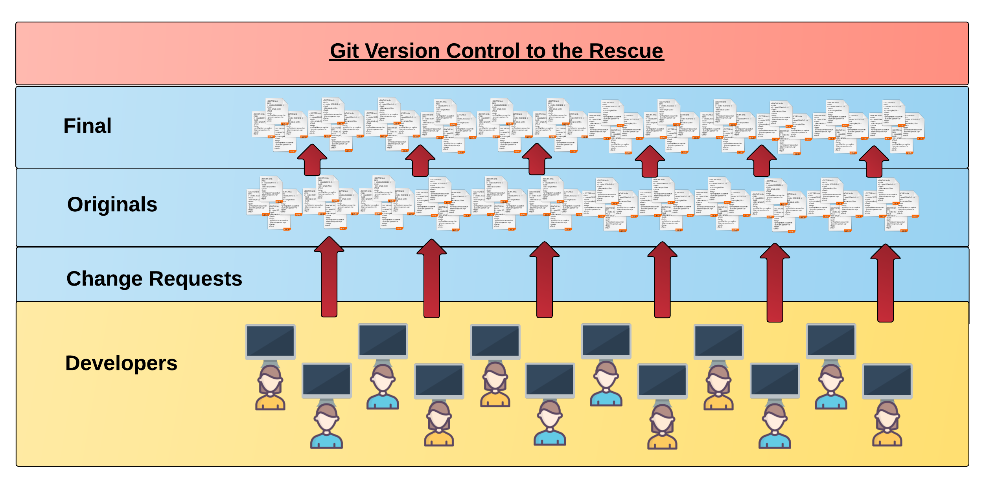
Collaborative Coding
Modern web development is highly collaborative.
Teams are often extremely large and separated across country (or planet).
Applications are often made up of hundreds or thousands of files.

Slide 4
Git Clone + Push

Slide 5
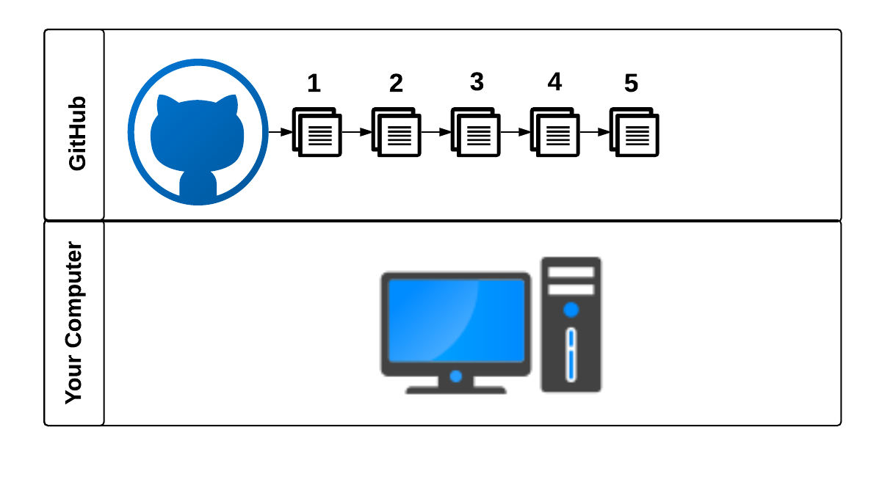
Fundamentally…

Slide 6
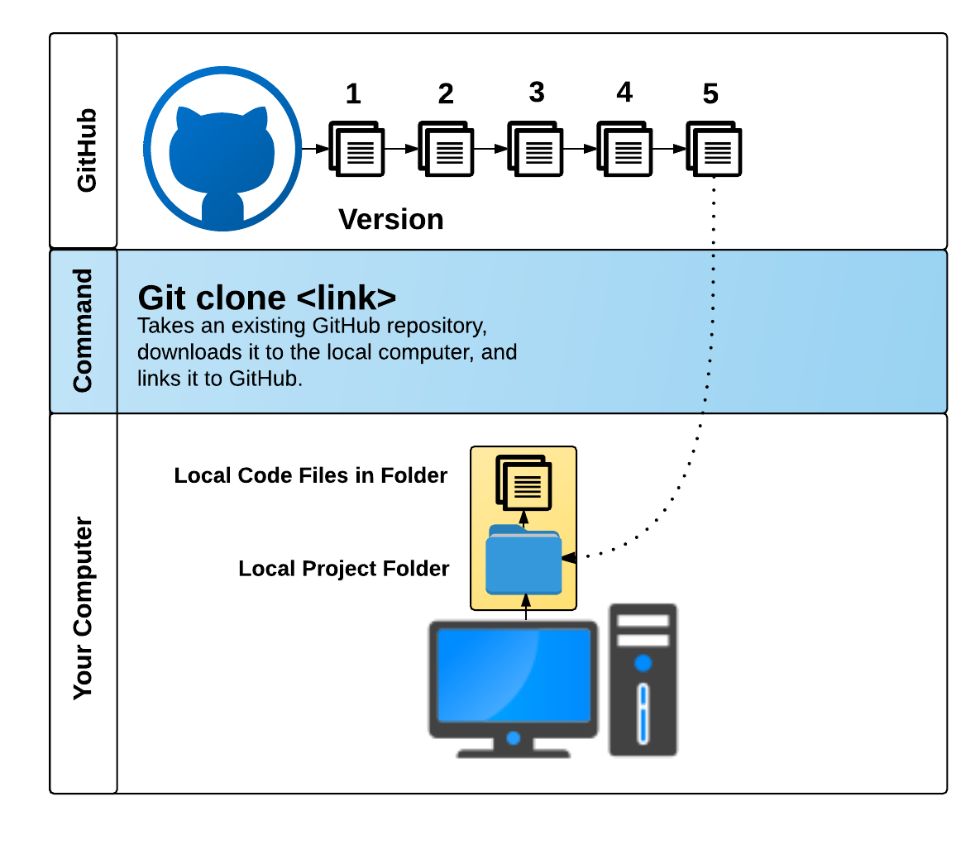

Slide 7
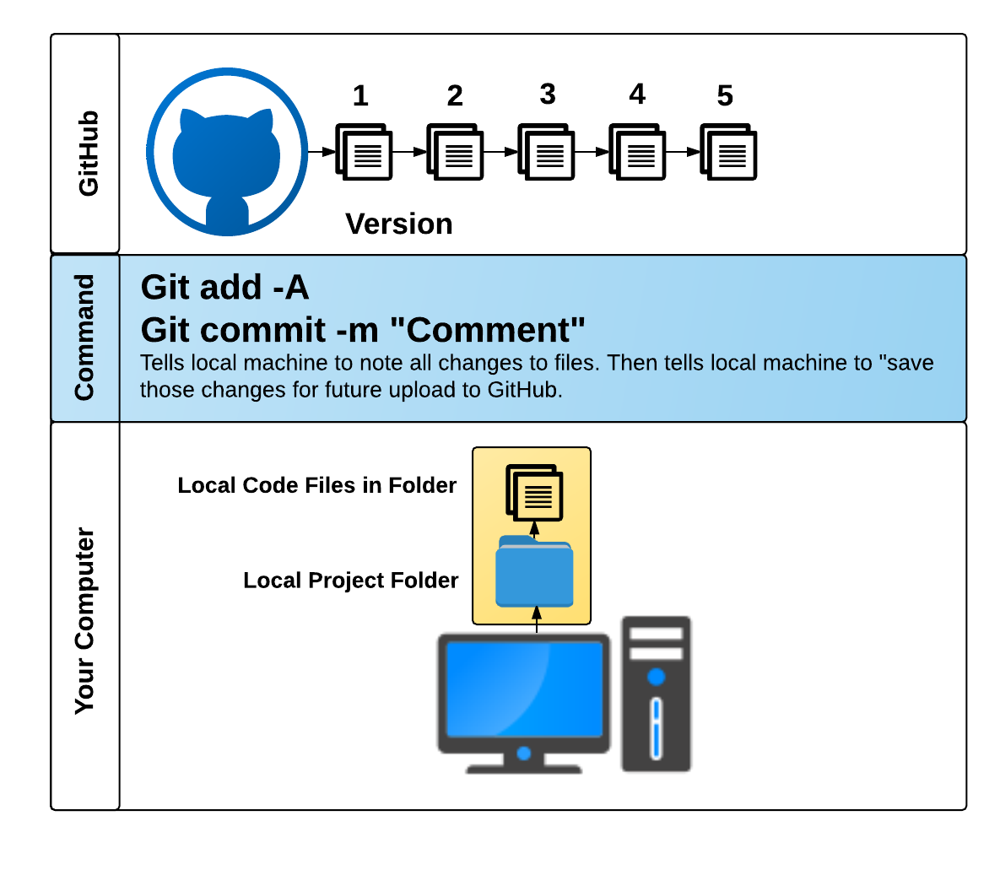

Slide 8
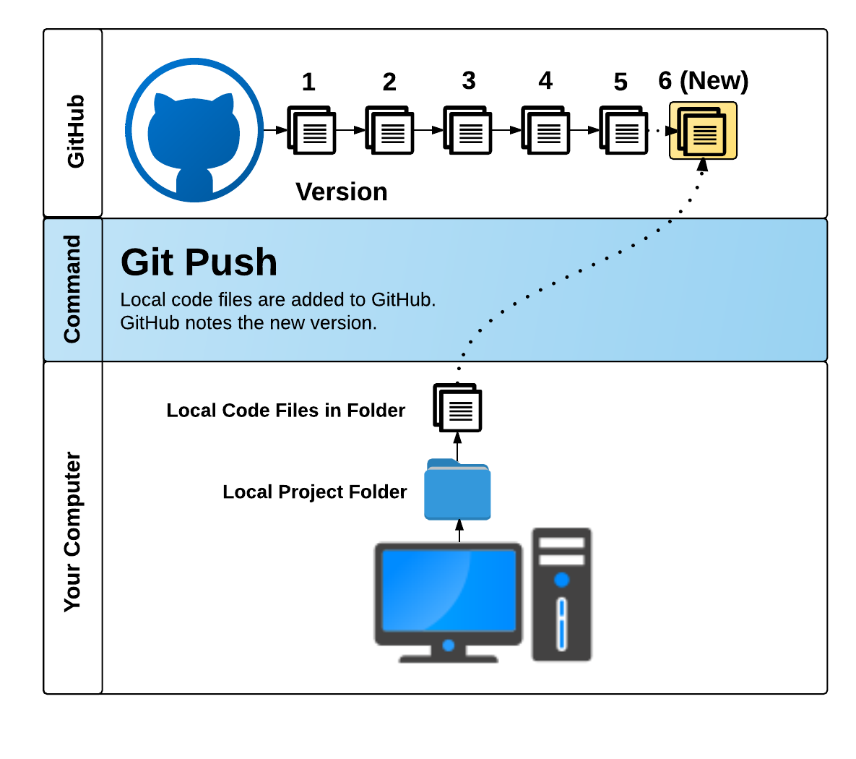

Slide 9
Git Branch, Checkout

Slide 10
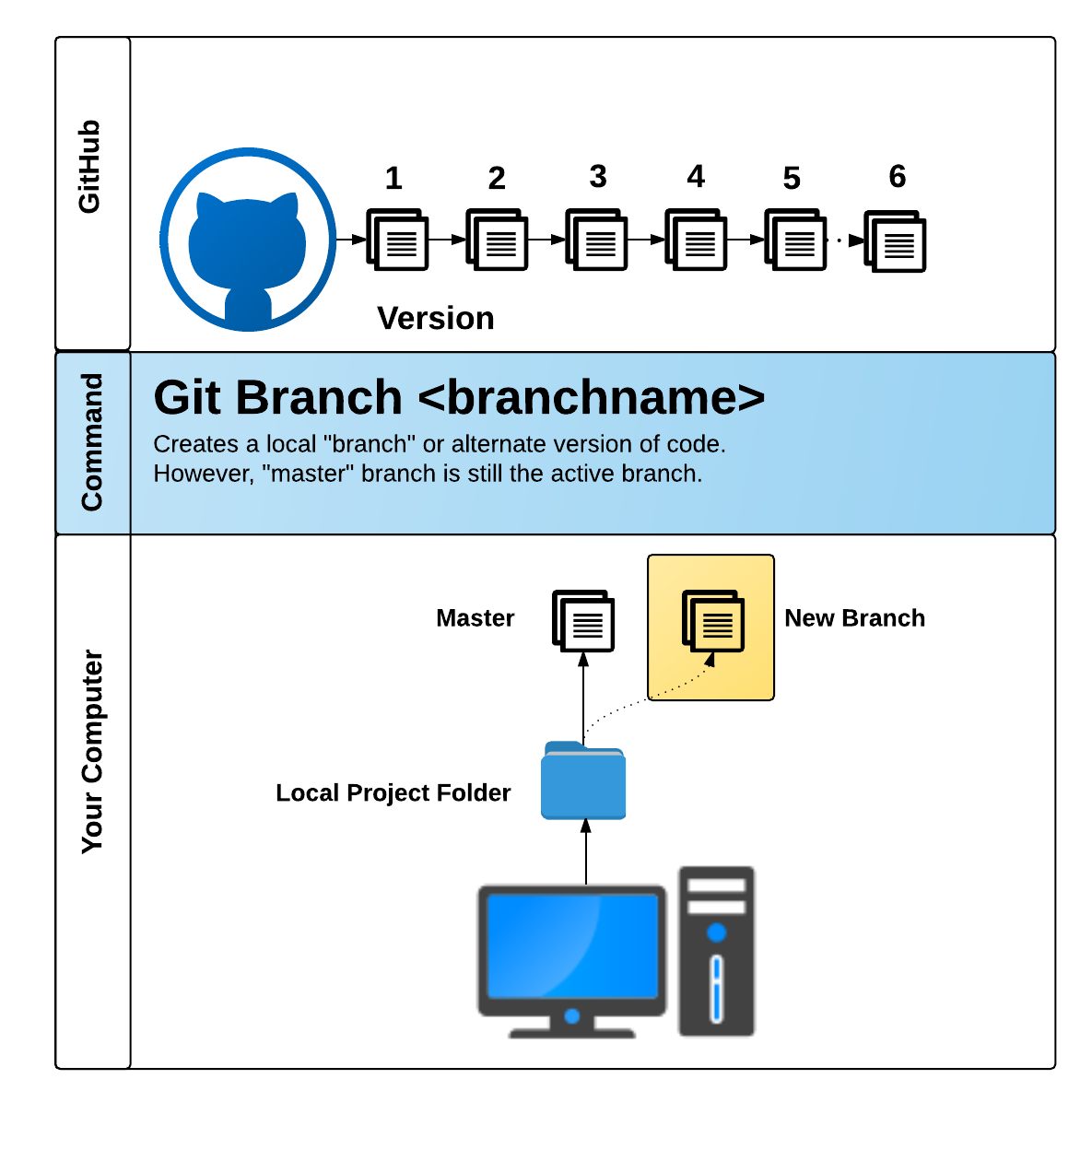

Slide 11
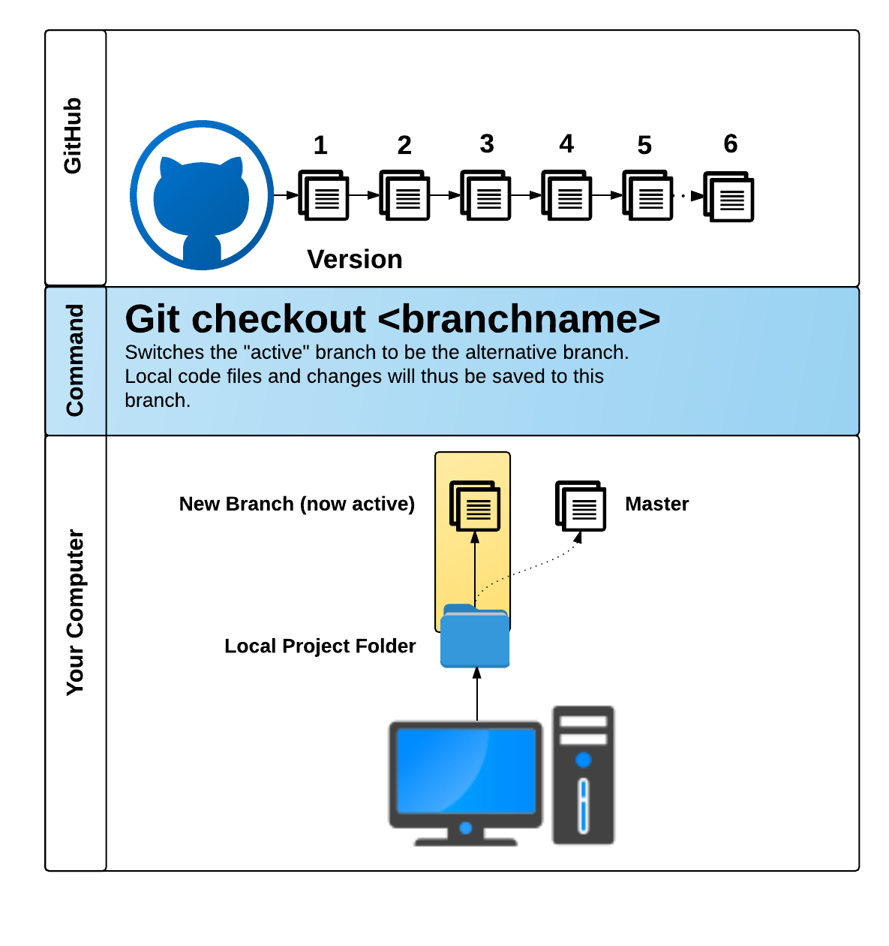

Slide 12
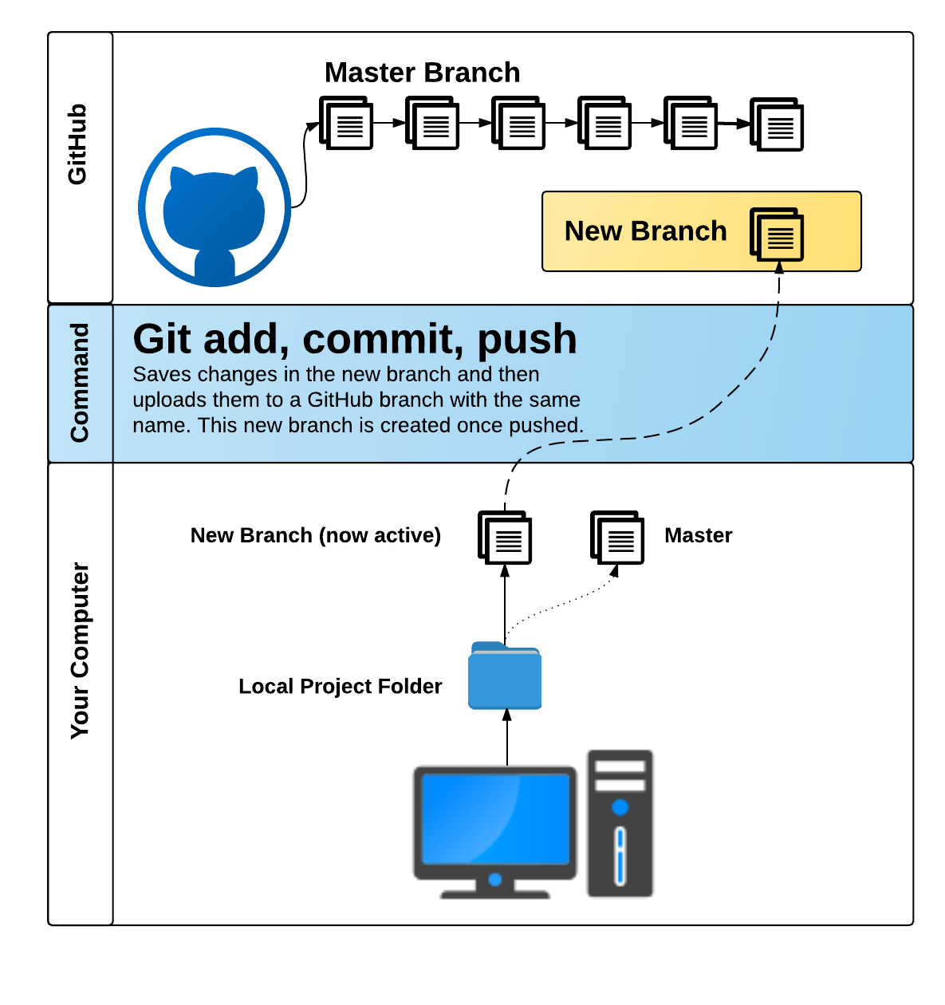

Slide 13
Git Pull Requests

Slide 14
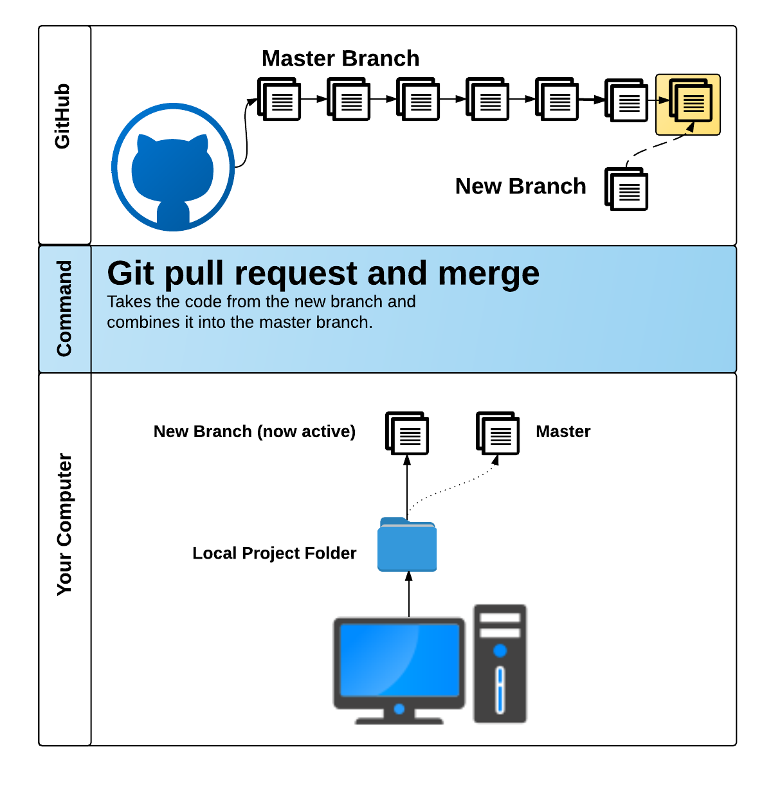

Slide 15
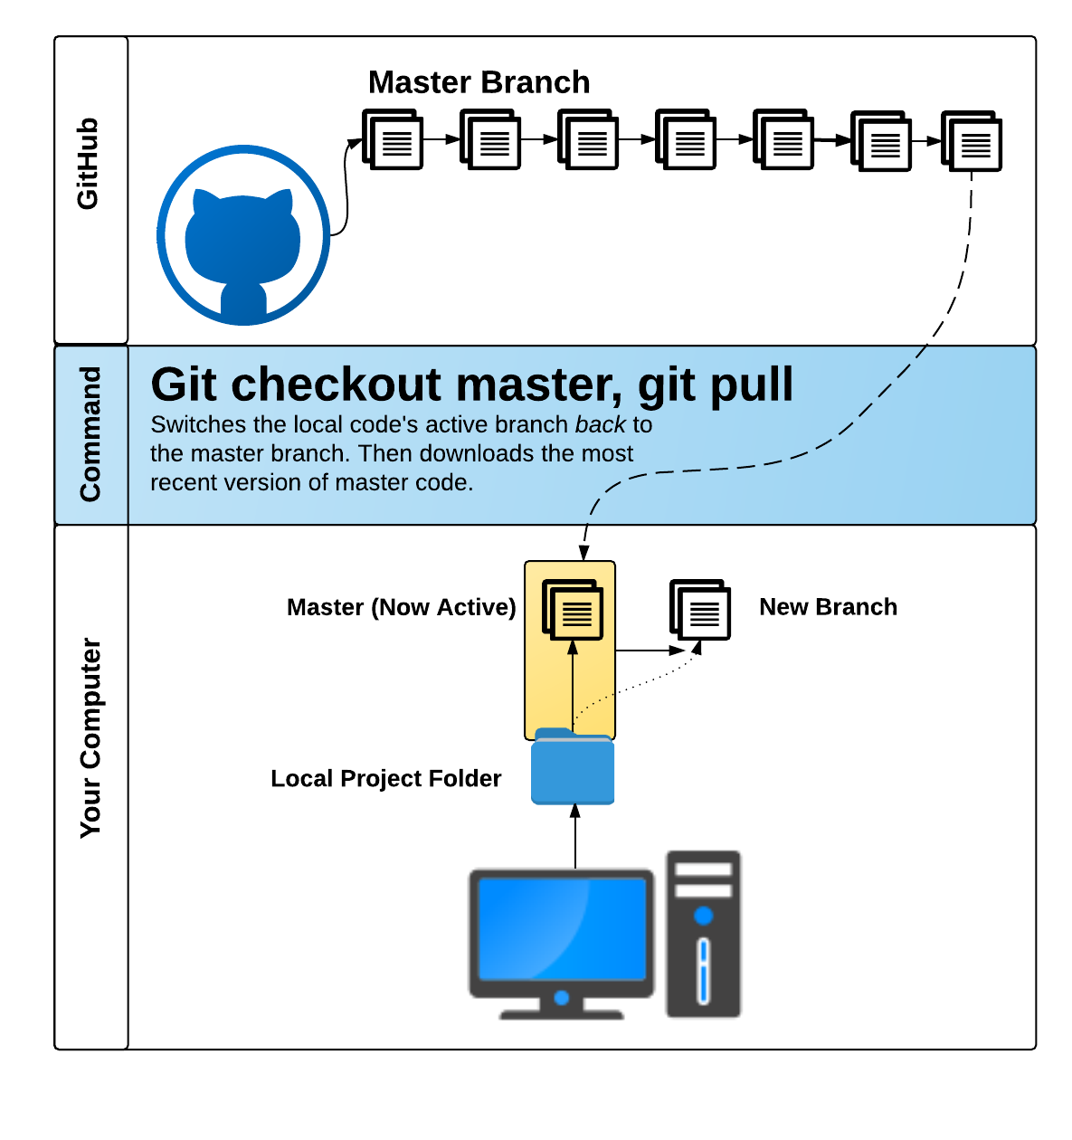

Slide 16
Questions?

